Slide 1

UPHORIA
HACKATHON
Anime App
~ Akarsh Jain
~ Ramanuj Goel

Slide 2
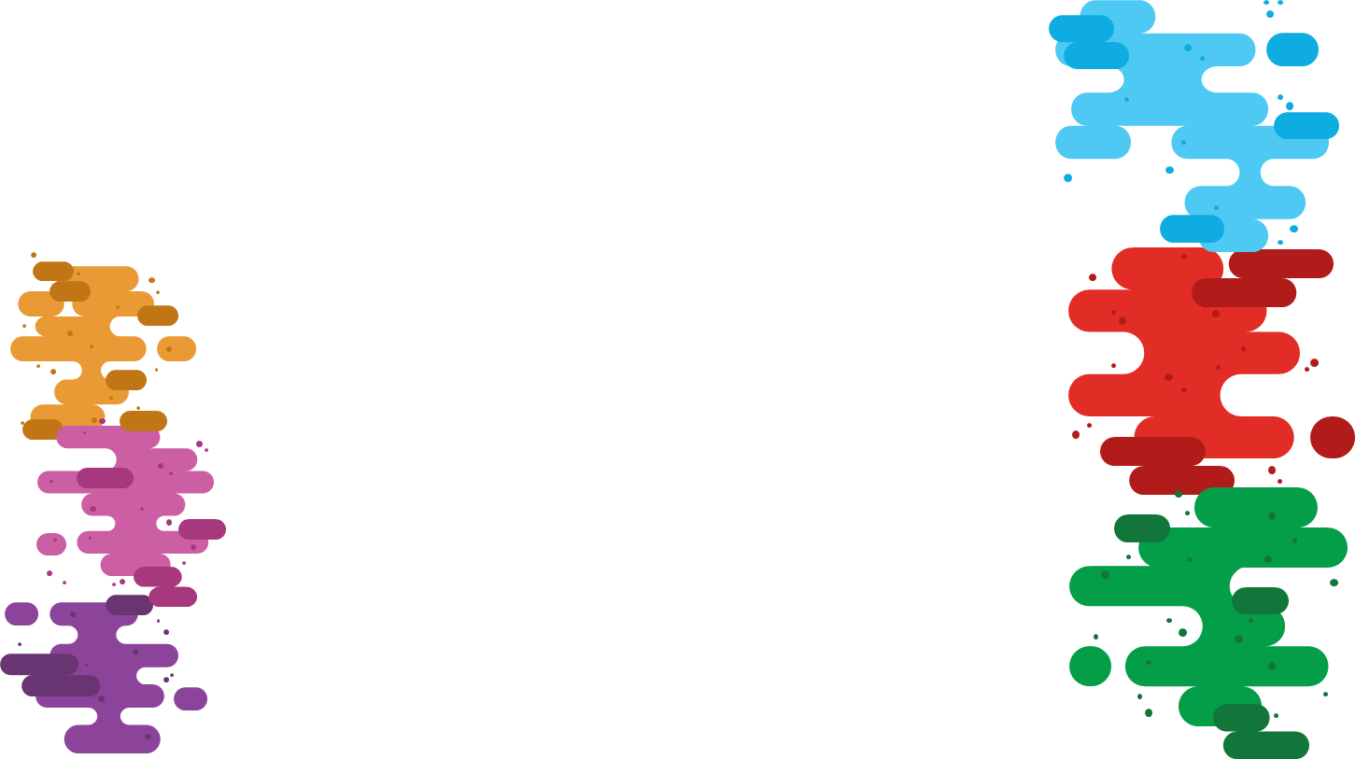
Goals
To Provide a single platform to browse Anime, manga and other anime related content.
Strong integration with platforms like MyAnimeList, AniList, AnimeNewsNetwork and more
Providing communication links with anime related social media like reddit and youtube
Integration with streaming sites to provide a convenient experience

Slide 3
Features
A search-bar that connects with the jikan Api from MAL
Options for searching anime, mangas as well as characters
Storing recent searches and presenting them to the user
List view of all search results
Information about each result if you click on it

Slide 4
Future Prospects
Include API’s from more websites
Storing favorite animes/mangas/characters and logins of different websites
Providing anime and manga streams from youtube, gogostream and 4Anistream
Improved colour combination (User Interface) and providing customizability
More detailed Information about each result if you click on it

Slide 5
TimeLine
Integrating ANN API (unsuccessful because of XML format conversion problems)
Development of structure of home page and search bar
Integration with Jikan API for MAL and adding categories for anime, manga and characters
Adding functionality of recent searches in search bar

Slide 6


Future TimeLine
Adding streams for manga and creating a document viewer for that purpose
Adding functionality for login into accounts for different websites
Integrating ANN and AniList API
Adding customizability and improvements to design
Integration with streams and creating a video player on the app itself

Slide 7
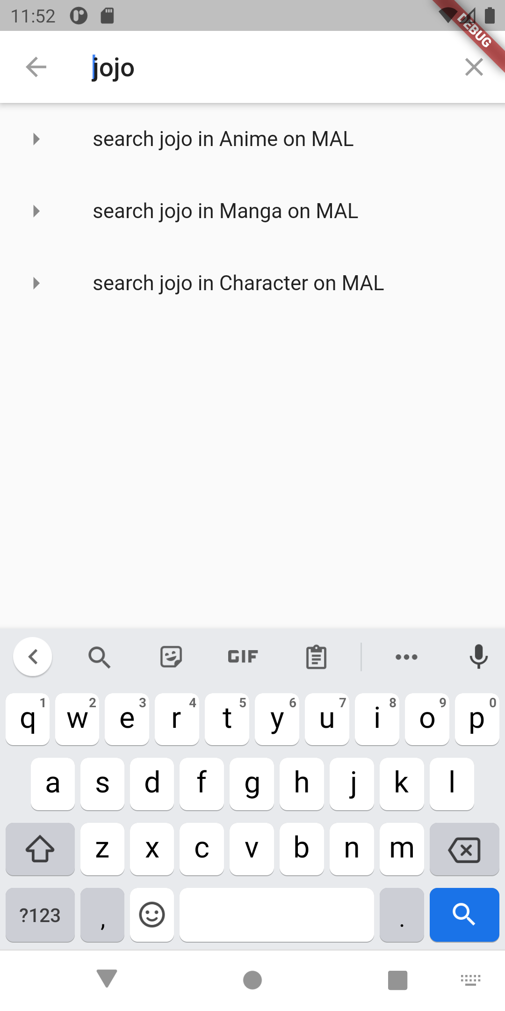
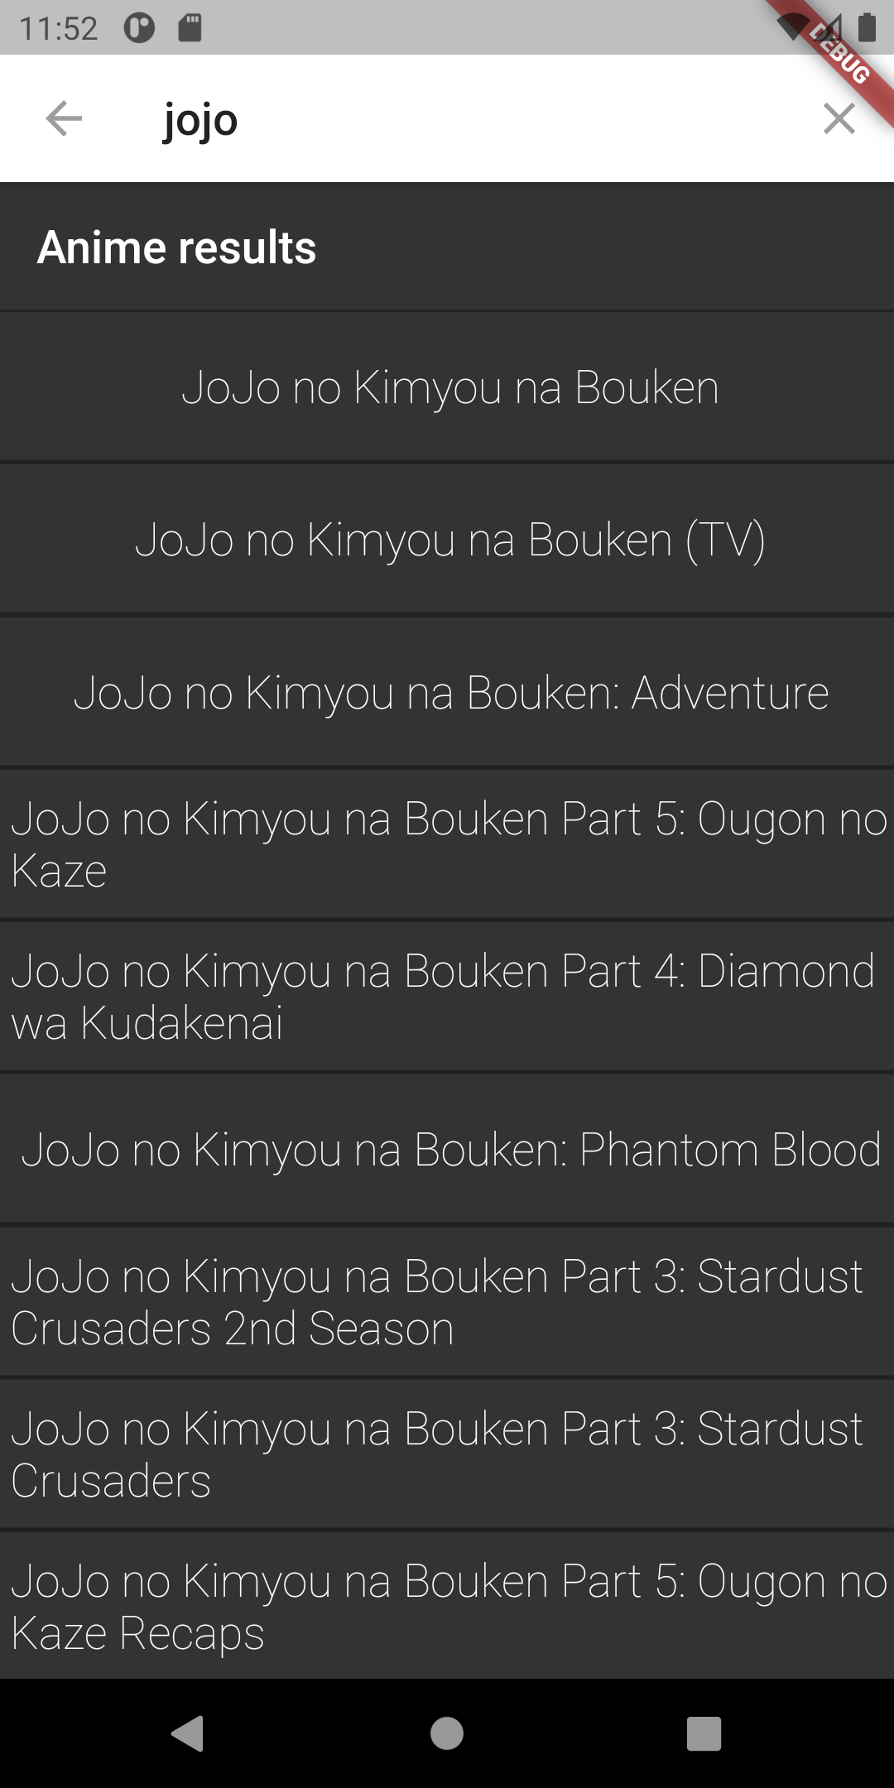
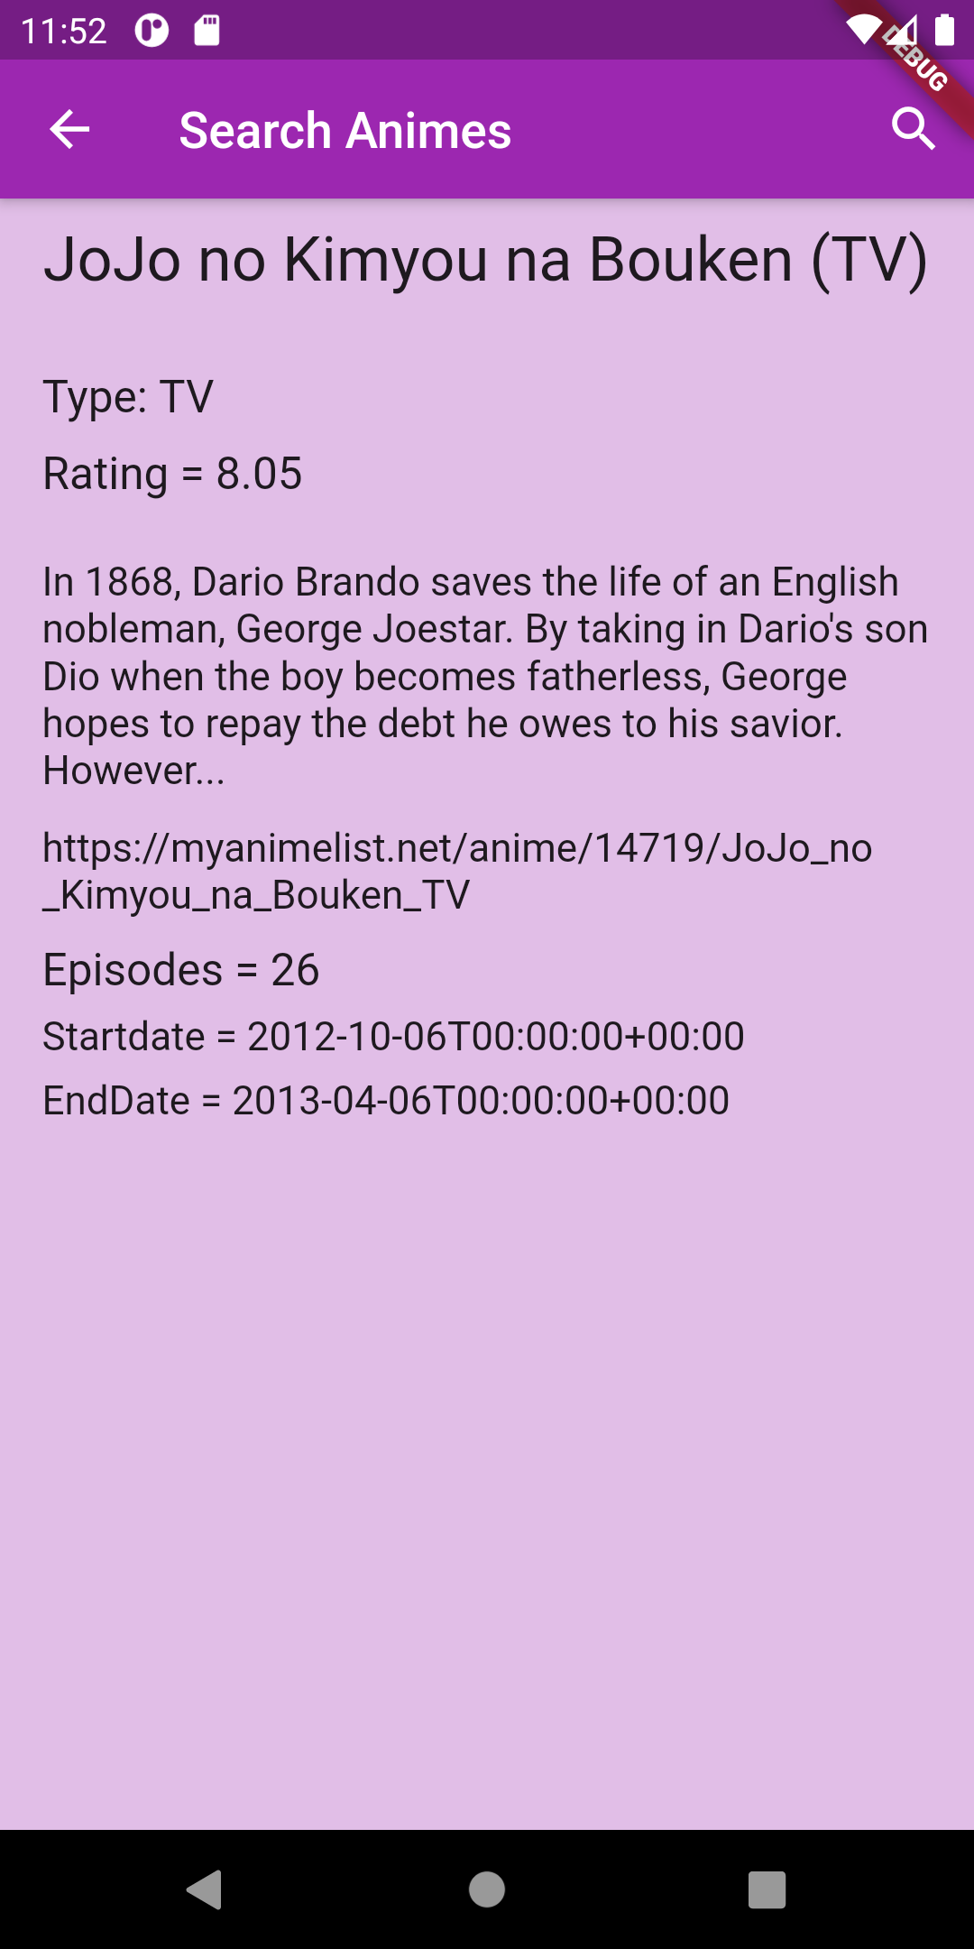
Picture Gallery

